Slide 1
Time Series Analysis
Renato R. Maaliw III, DIT
College of Engineering
Southern Luzon State University
Lucban, Quezon, Philippines

Slide 2
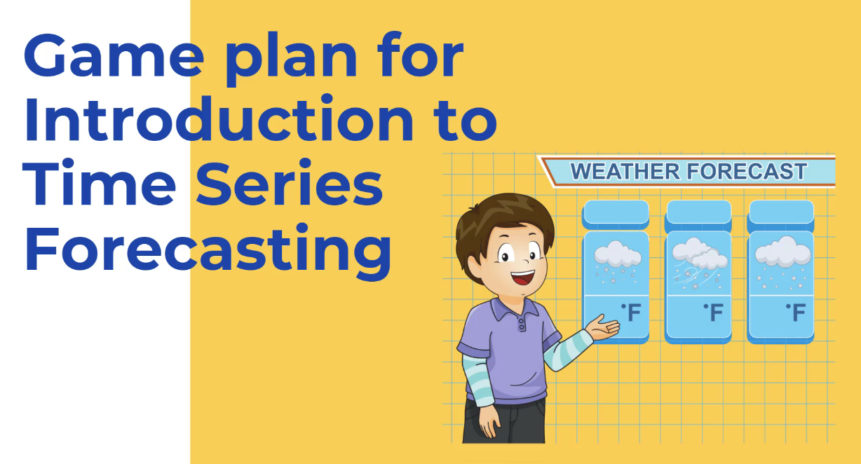

Slide 3
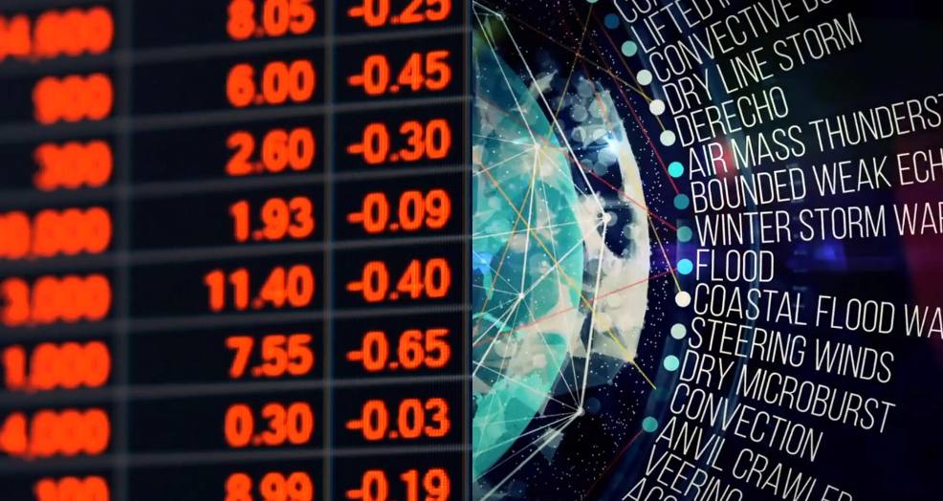

Slide 4
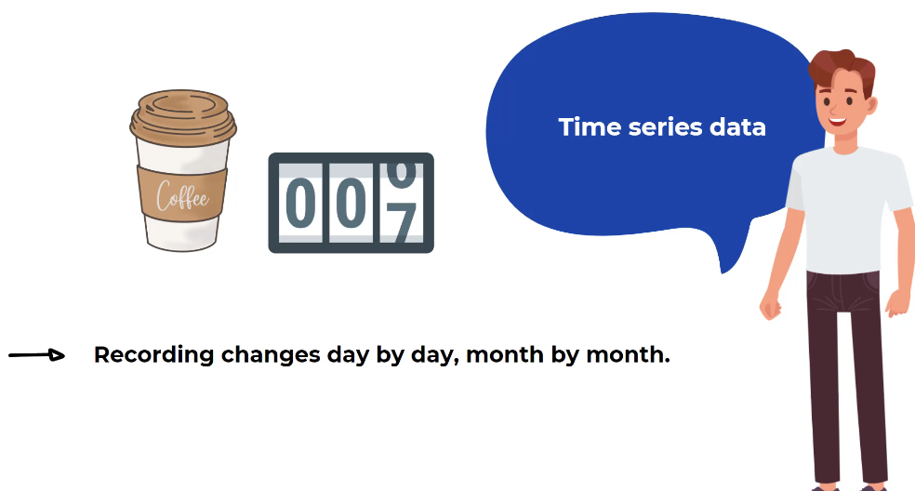

Slide 5


Slide 6


Slide 7
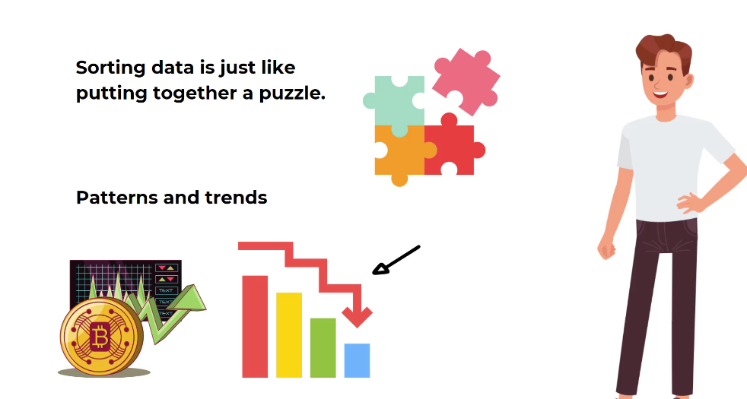

Slide 8
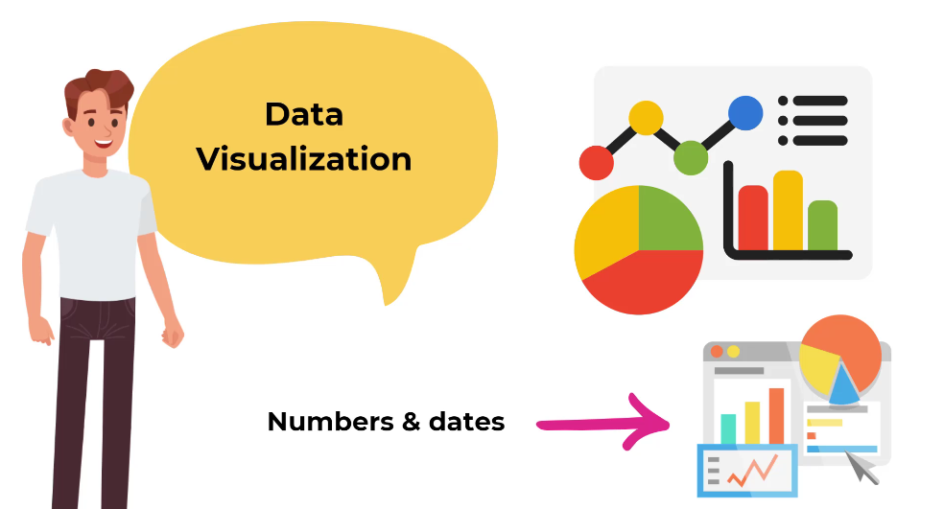

Slide 9
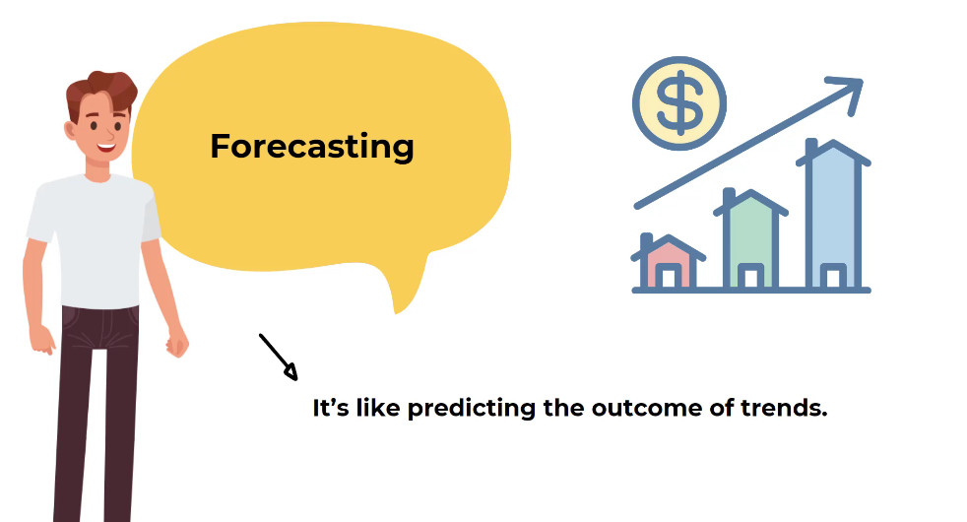

Slide 10
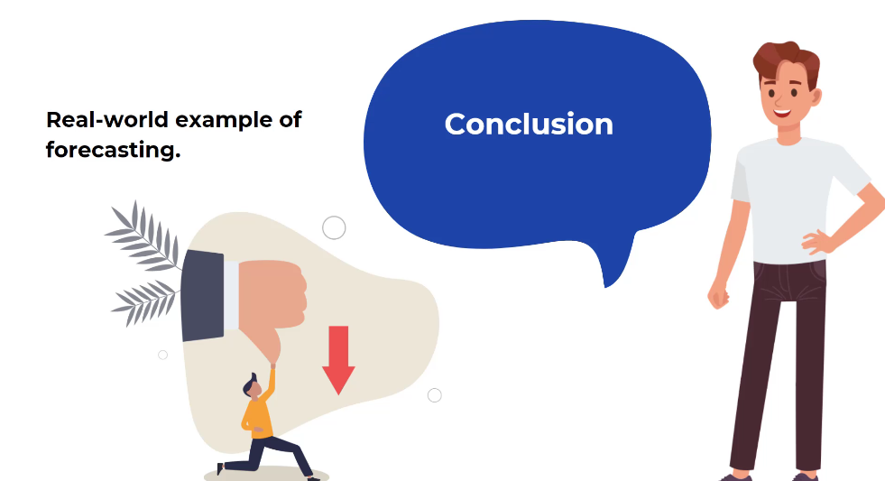

Slide 11
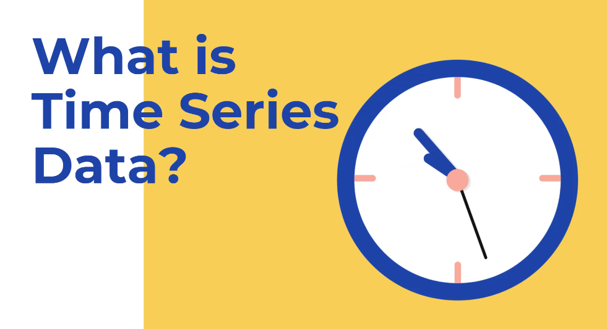

Slide 12
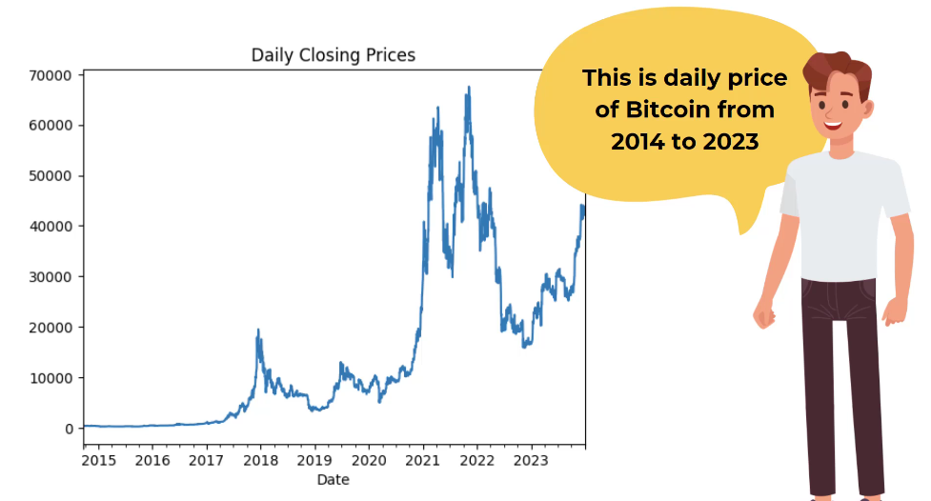

Slide 13
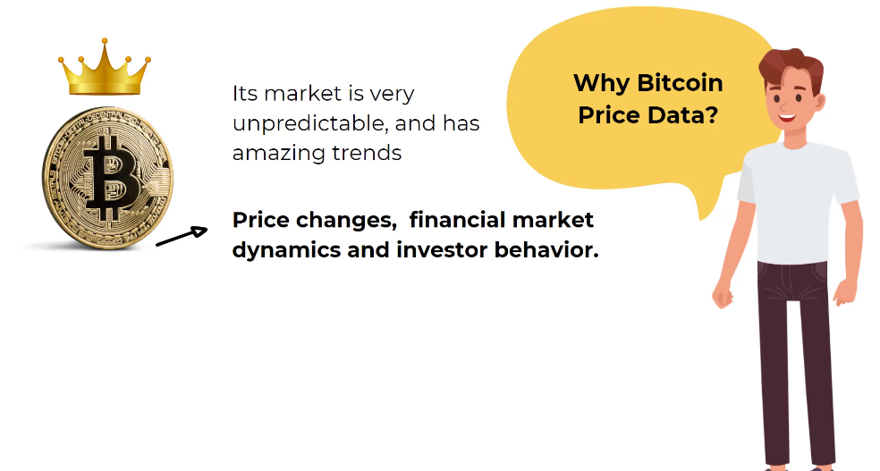

Slide 14
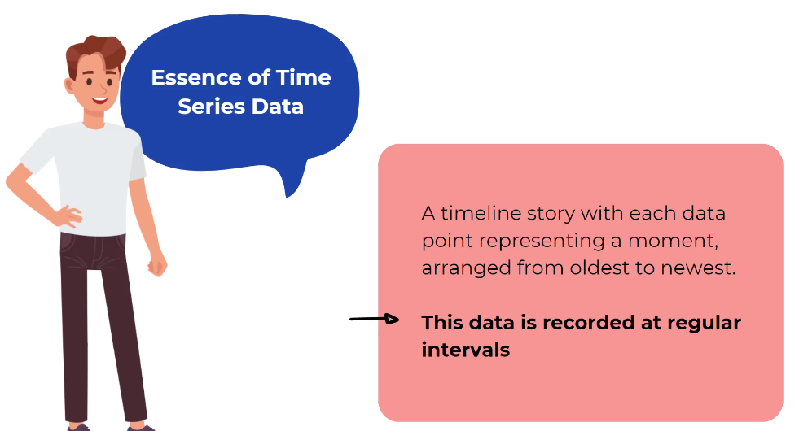

Slide 15
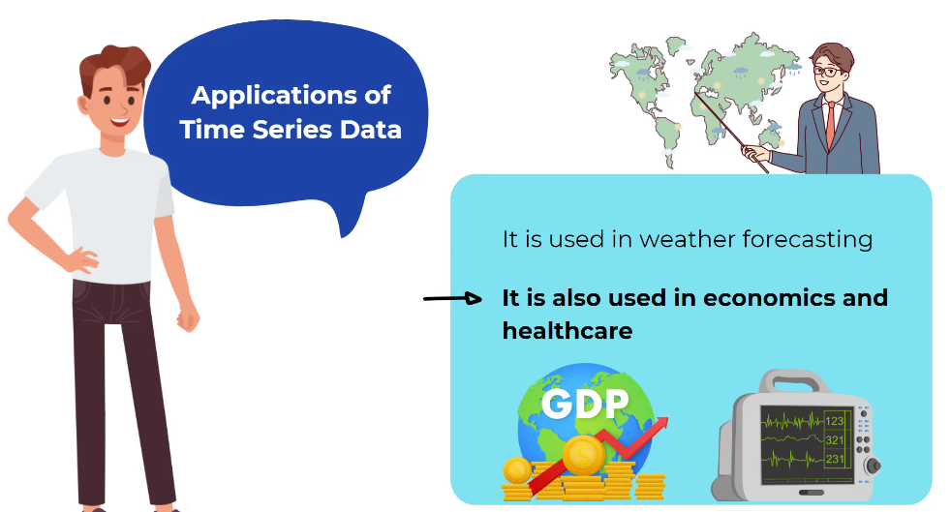

Slide 16
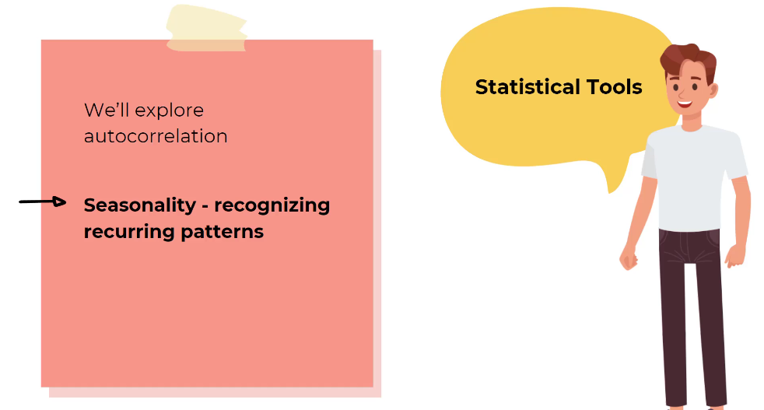

Slide 17


Slide 18
01. What best defines “time series data”
A. Observations collected across different entities at a single point in time
B. Observations collected without any inherent ordering
C. Observations recorded sequentially at fixed or irregular time intervals, where order and spacing carry information
D. Data that has been sorted alphabetically

Slide 19
01. What best defines “time series data”
A. Observations collected across different entities at a single point in time
B. Observations collected without any inherent ordering
C. Observations recorded sequentially at fixed or irregular time intervals, where order and spacing carry information
D. Data that has been sorted alphabetically

Slide 20
02. Which statement correctly captures the idea of seasonality in a time series
A. A one-time jump caused by an exogenous shock
B. A pattern that repeats at a regular, known frequency (e.g. hourly, weekly, yearly)
C. Noise that has zero mean and no autocorrelation
D. A permanent upward or downward drift in the mean level

Slide 21
02. Which statement correctly captures the idea of seasonality in a time series
A. A one-time jump caused by an exogenous shock
B. A pattern that repeats at a regular, known frequency (e.g. hourly, weekly, yearly)
C. Noise that has zero mean and no autocorrelation
D. A permanent upward or downward drift in the mean level

Slide 22
03. Which of the following is not a common application o time series analysis
A. Forecasting electricity demand for grid management
B. Detecting credit-card fraud by examining transaction sequences
C. Monitoring a patient’s heart-rate signal in real-time
D. Ranking search-engine results based purely on keyword relevance

Slide 23
03. Which of the following is not a common application o time series analysis
A. Forecasting electricity demand for grid management
B. Detecting credit-card fraud by examining transaction sequences
C. Monitoring a patient’s heart-rate signal in real-time
D. Ranking search-engine results based purely on keyword relevance

Slide 24
[Code Demo]

Slide 25
04. Which string representation is the most widely adopted international standard for machine-readable dates in time series files?
A. MM/DD/YYYY
B. DD-MM-YYYY
C. YYY-MM-DD
D. YY/MM/DD

Slide 26
03. Which string representation is the most widely adopted international standard for machine-readable dates in time series files?
A. MM/DD/YYYY
B. DD-MM-YYYY
C. YYY-MM-DD
D. YY/MM/DD

Slide 27
05. What is the main purpose of applying a rolling (moving) average to a time series?
A. To increase the sampling frequency of the data
B. To eliminate all seasonal effects
C. To smooth short-term fluctuations
D. To convert a non-stationary series into a stationary one via differencing

Slide 28
05. What is the main purpose of applying a rolling (moving) average to a time series?
A. To increase the sampling frequency of the data
B. To eliminate all seasonal effects
C. To smooth short-term fluctuations
D. To convert a non-stationary series into a stationary one via differencing

Slide 29
06. When you create a feature like df[‘lag_1’] = df[‘Close’].shift(1), what does that variable represent, and how can it be interpreted in a business-forecasting context?
A. The day-to-day percentage change in price, useful only for volatility charts
B. The value of the series exactly one period earlier
C. A seasonal dummy that identifies weekends
D. A rolling average that smooths noise

Slide 30
06. When you create a feature like df[‘lag_1’] = df[‘Close’].shift(1), what does that variable represent, and how can it be interpreted in a business-forecasting context?
A. The day-to-day percentage change in price, useful only for volatility charts
B. The value of the series exactly one period earlier
C. A seasonal dummy that identifies weekends
D. A rolling average that smooths noise

Slide 31
Thank you very much for listening.

